Slide 1
Diabetes Risk Prediction and Analysis Using Clinical and Lifestyle Factors
Ritik Sunil Toksiya
UMBC DATA 606 – Capstone
Advisor: Dr. Chaojie (Jay) Wang
Spring 2026

Slide 2
Agenda
Problem Statement & Motivation
Dataset Overview
Exploratory Data Analysis (EDA)
Feature Engineering
Data Preprocessing
Model Training & Results
Model Evaluation
SHAP Analysis
Streamlit App Demo
Conclusion & Next Steps

Slide 3
Problem Statement & Motivation
- Diabetes affects 34.2 million Americans — millions more are undiagnosed
- Prediabetes affects 88 million Americans with most unaware of their condition
- Early identification of high-risk individuals can:
- Encourage lifestyle changes
- Support early medical consultation
- Help public health officials target prevention efforts
- Goal: Build a machine learning model to predict diabetes risk using
clinical, lifestyle and demographic factors from CDC survey data
- This is a Supervised Multiclass Classification Problem
- Class 0 = No Diabetes
- Class 1 = Prediabetes
- Class 2 = Diabetes

Slide 4
Dataset Overview
Source
CDC Behavioral Risk Factor Surveillance System (BRFSS) 2015
https://www.kaggle.com/datasets/alexteboul/diabetes-health-indicators-dataset
Dataset Size
↳ 253,680 records | 22 features | No missing values
Feature Categories
↳ Clinical: BMI, HighBP, HighChol, Stroke, HeartDiseaseorAttack
↳ Lifestyle: Smoker, PhysActivity, Fruits, Veggies, HvyAlcoholConsump
↳ Demographics: Age, Sex, Education, Income
Target Variable — Diabetes_012
↳ 0 = No Diabetes → 213,703 samples (84.24%)
↳ 1 = Prediabetes → 4,631 samples ( 1.83%)
↳ 2 = Diabetes → 35,346 samples (13.93%)

Slide 5
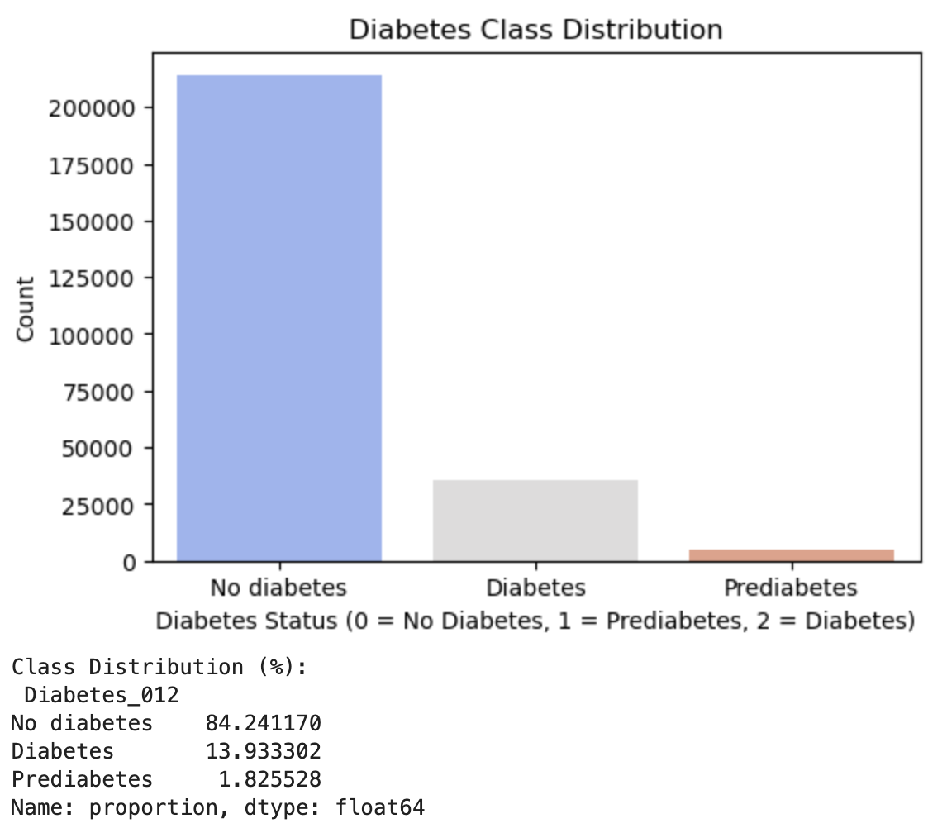
Exploratory Data Analysis
Class Distribution
↳ Severe class imbalance detected
↳ No Diabetes dominates at 84.24%
↳ Prediabetes severely underrepresented at only 1.83%
↳ Requires SMOTE oversampling before model training

Slide 6
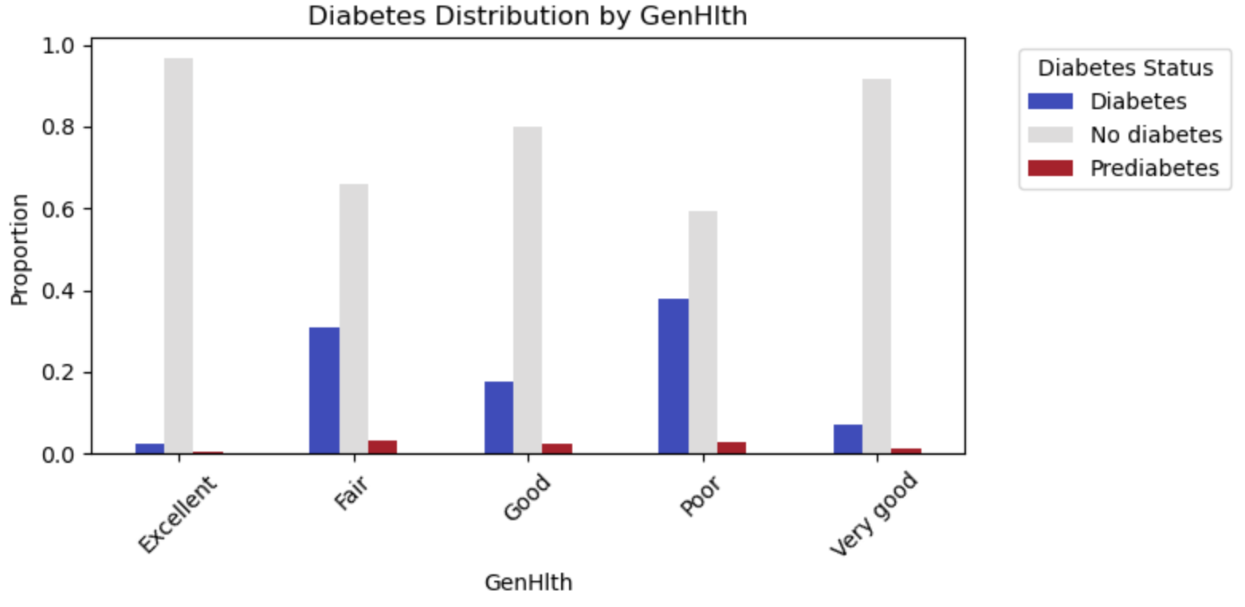
EDA — Categorical Features Analysis
Key Findings
↳ HighBP: 37% in healthy vs 75% in diabetic respondents
↳ HighChol: High cholesterol strongly associated with diabetes
↳ GenHlth: Strongest categorical predictor — poor health = higher diabetes risk
↳ HeartDisease: History of heart disease linked to diabetes
↳ Age: Diabetes risk increases steeply after age group 50-54
↳ PhysActivity: Active respondents show lower diabetes rates
↳ Income: Higher income associated with lower diabetes rates
↳ Education: College graduates show lowest diabetes rates

Slide 7
EDA — Numerical Features Analysis
3 Numerical Features: BMI, MentHlth, PhysHlth
BMI ↳ Right skewed distribution — most between 20-35
↳ No Diabetes median BMI: 27.7
↳ Prediabetes median BMI: 30.7
↳ Diabetes median BMI: 31.9
↳ Higher BMI clearly associated with diabetes risk
MentHlth
↳ Heavily zero-inflated
↳ Most respondents report 0 bad mental health days
↳ Not a strong separator between classes
PhysHlth
↳ Also zero-inflated but stronger predictor
↳ No Diabetes median: 0 days
↳ Diabetes median: ~15 bad physical health days per month
↳ Strong differentiator between classes

Slide 8
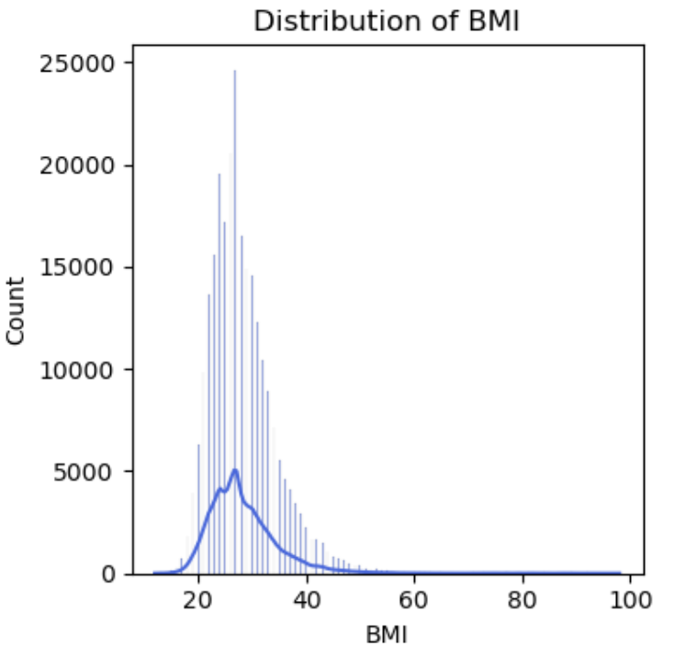
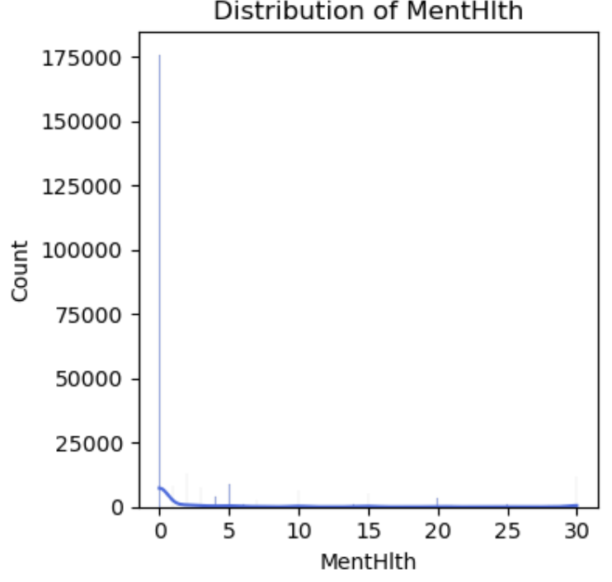
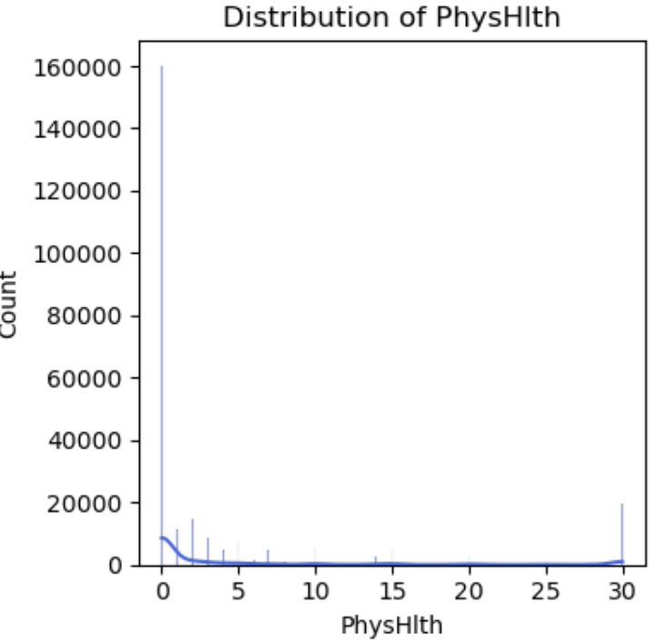
Numerical Features Distribution

Slide 9
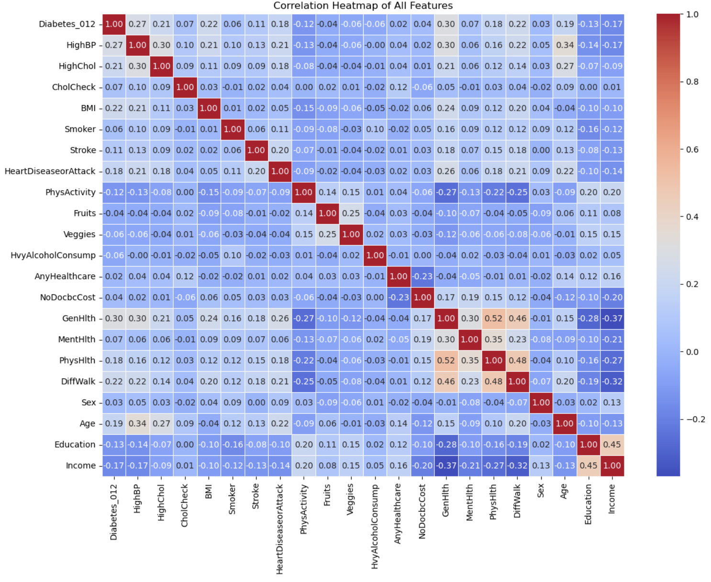
EDA — Correlation Heatmap
Top Positive Correlations with Diabetes
↳ GenHlth → 0.30 (strongest predictor)
↳ HighBP → 0.27
↳ BMI → 0.22
↳ DiffWalk → 0.22
↳ HighChol → 0.21
↳ Age → 0.19
↳ HeartDisease → 0.18 Negative Correlations (Protective Factors)
↳ Income → -0.17 ↳ Education → -0.13
↳ PhysActivity → -0.12 Notable Feature Correlations
↳ GenHlth & PhysHlth → 0.52
↳ Education & Income → 0.45

Slide 10
Feature Engineering
3 New Features Created
BMI_Category
↳ Categorizes BMI into 4 groups using WHO standards
↳ 1=Underweight (<18.5) 2=Normal (18.5-24.9)
3=Overweight (25-29.9) 4=Obese (≥30)
↳ Correlation with target: 0.21
Health_Score
↳ MentHlth + PhysHlth
↳ Captures overall health burden
↳ Correlation with target: 0.16
Lifestyle_Risk
↳ Smoker + HvyAlcoholConsump + (1 - PhysActivity)
↳ Higher score = unhealthier lifestyle
↳ Correlation with target: 0.10
Dataset shape: 22 features → 25 features after engineering

Slide 11
Data Preprocessing
1. Feature Encoding
↳ Binary columns (Yes/No) → mapped to 1/0
↳ Sex → Male=1, Female=0
↳ GenHlth → Excellent=1 to Poor=5
↳ Age → 18-24=1 to 80+=13
↳ Education → 1-6, Income → 1-8
↳ Target → No Diabetes=0, Prediabetes=1, Diabetes=2
2. Train/Test Split
↳ 80% Training | 20% Testing
↳ Stratified split to preserve class distribution
3. SMOTE — Handling Class Imbalance
↳ Applied only on training data
↳ Before: 0=170,962 | 1=3,705 | 2=28,277
↳ After: 0=170,962 | 1=170,962 | 2=170,962
↳ Total training samples: 202,944 → 512,886
4. Feature Scaling — StandardScaler
↳ Mean = 0, Standard Deviation = 1
↳ Ensures all features treated fairly
↳ No data leakage confirmed

Slide 12
Model Training & Results
3 Models Trained
Logistic Regression
↳ Baseline linear model
↳ Training: 56.5% | Testing: 66.1%
↳ Underfitting — too simple for this dataset
Random Forest
↳ 100 decision trees
↳ Training: 99.2% | Testing: 78.3%
↳ Overfitting — large gap between train and test
XGBoost ✓ Best Model
↳ Gradient boosting — sequential tree building
↳ Training: 73.9% | Testing: 74.8%
↳ Most balanced — no overfitting

Slide 13
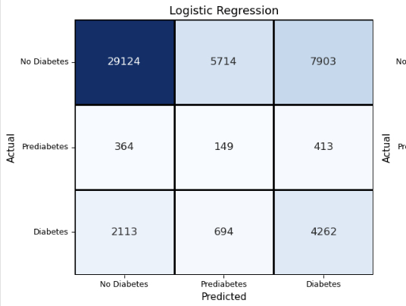
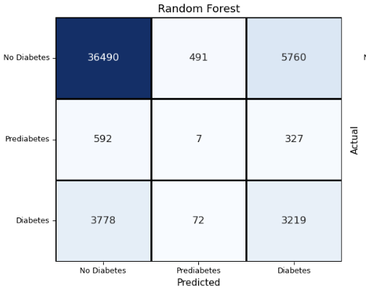
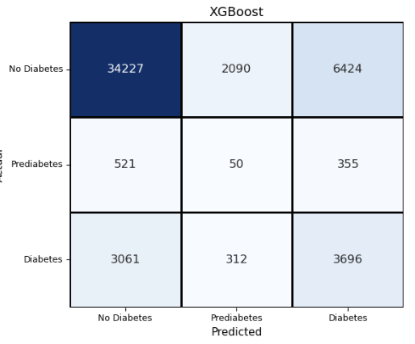
Classification Report
Key Metrics Explained
↳ Precision: Of all predicted positives how many were correct
↳ Recall: Of all actual positives how many were detected
↳ F1-Score: Balance between precision and recall
XGBoost — Best Model
↳ No Diabetes F1: 0.85 ✓
↳ Prediabetes F1: 0.03 ✗
↳ Diabetes F1: 0.42
↳ Overall Accuracy: 75%
Key Challenge — Prediabetes
↳ All models struggle with Prediabetes class
↳ Only 926 test samples vs 42,741 No Diabetes
↳ Real world challenge — prediabetes often undiagnosed
↳ Future work: cost-sensitive learning

Slide 14
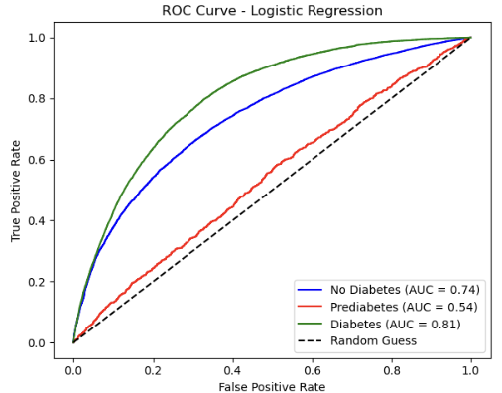
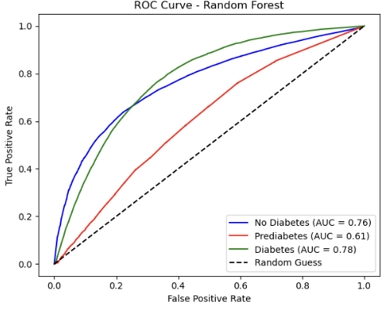
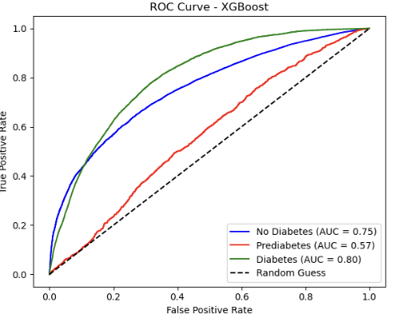
ROC Curve Analysis
What is ROC Curve?
↳ Shows how well model distinguishes between classes
↳ AUC closer to 1.0 = better performance
↳ AUC = 0.50 = random guessing
Results
Logistic Regression
↳ No Diabetes AUC: 0.74
↳ Prediabetes AUC: 0.54
↳ Diabetes AUC: 0.81
Random Forest
↳ No Diabetes AUC: 0.76
↳ Prediabetes AUC: 0.61
↳ Diabetes AUC: 0.78
XGBoost ✓
↳ No Diabetes AUC: 0.75
↳ Prediabetes AUC: 0.57
↳ Diabetes AUC: 0.80

Slide 15
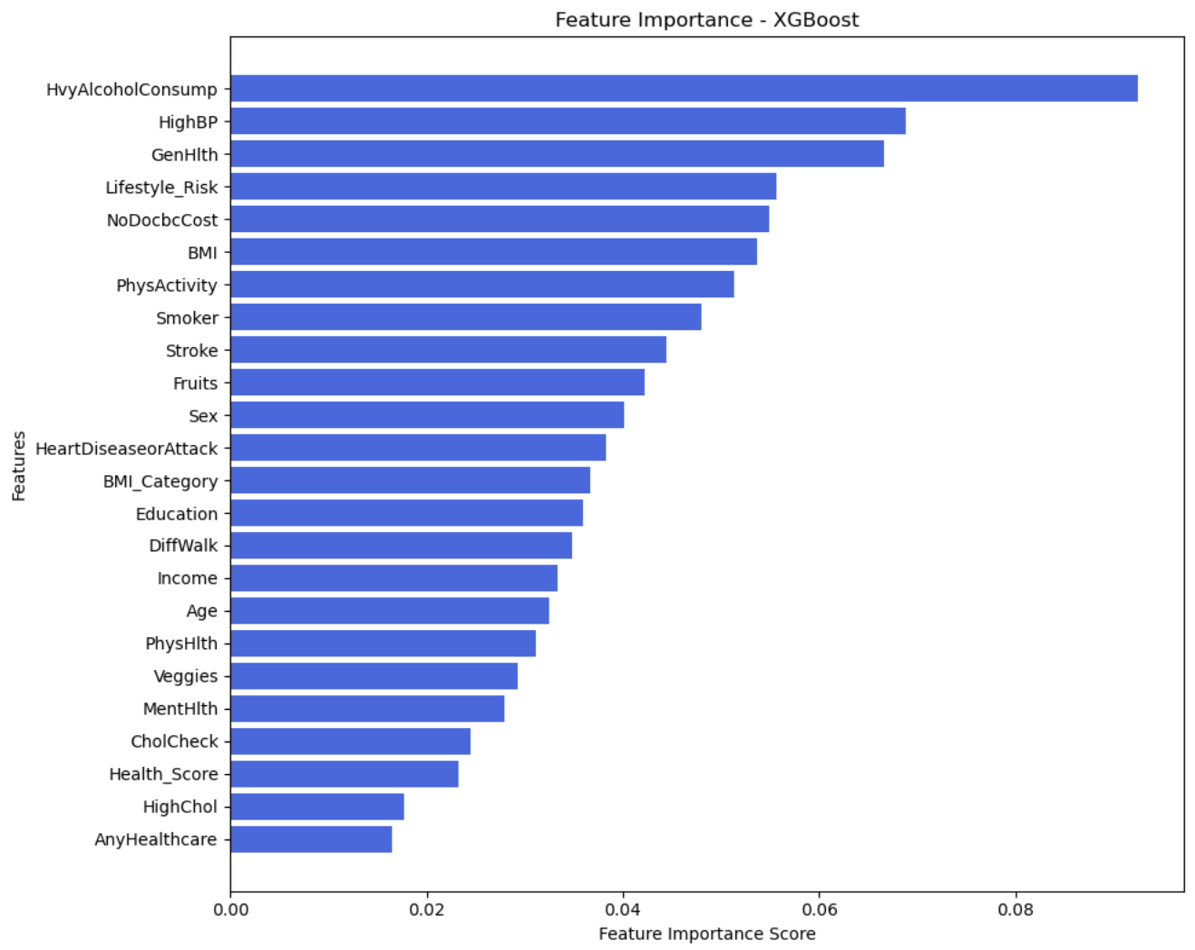
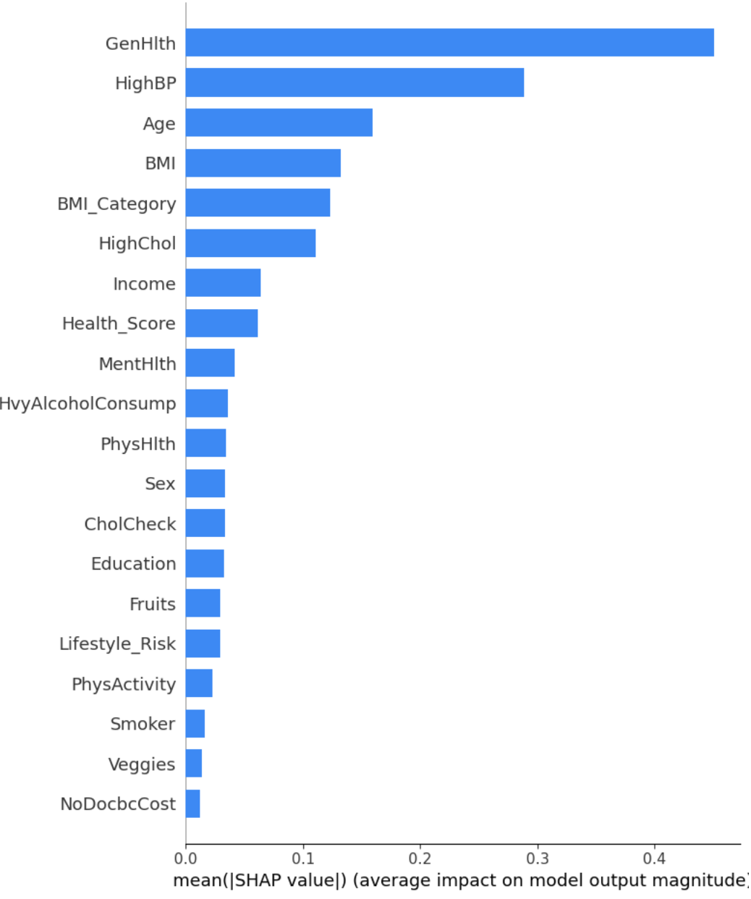
Feature Importance & SHAP Analysis
Random Forest Feature Importance
↳ BMI — strongest predictor
↳ Age and Income follow
↳ Health_Score ranks 4th (engineered feature)
↳ GenHlth, PhysHlth, Education also important
XGBoost Feature Importance
↳ HvyAlcoholConsump ranks 1st (misleading)
↳ Standard feature importance measures split frequency
↳ Not always clinically meaningful
SHAP Analysis — More Reliable
↳ GenHlth — strongest predictor
↳ HighBP — second most important
↳ Age — third
↳ BMI — fourth
↳ BMI_Category (engineered) — top 10
↳ Health_Score (engineered) — top 10
Key Takeaway
↳ SHAP confirms clinical knowledge
↳ Engineered features added real value
↳ HvyAlcoholConsump drops significantly in SHAP
confirming standard importance was misleading

Slide 16
Cross Validation
5-Fold Cross Validation Results
Logistic Regression
↳ CV Mean: 56.09% | Std: ±0.30% | Consistent but underfitting
Random Forest
↳ CV Mean: 90.64% | Std: ±3.36% | High variance — overfitting
XGBoost ✓
↳ CV Mean: 72.11% | Std: ±3.59% | Most stable and reliable
Key Takeaway
↳ XGBoost CV accuracy (72%) is close to test accuracy (74.8%)
↳ Confirms model generalizes well on unseen data
↳ Random Forest high std confirms it memorized training data
↳ XGBoost is our final chosen model

Slide 17
Streamlit Web Application
Live App
↳ Click here to open the app
Features
↳ BMI Calculator — auto calculates from weight and height
↳ Clinical Indicators input form
↳ Lifestyle Factors input form
↳ Demographics input form
↳ Predicts No Diabetes, Prediabetes or Diabetes
↳ Shows confidence score for prediction
↳ Personalized health recommendations
↳ Risk Factor Summary — BMI, Health Score, Lifestyle Risk
Tech Stack
↳ Python | Streamlit | XGBoost | Joblib
↳ Deployed on Streamlit Community Cloud
↳ Connected to GitHub repo for auto updates

Slide 18
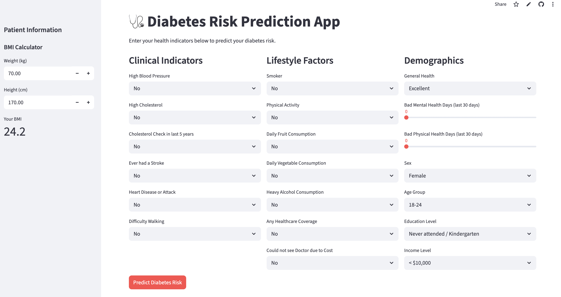

Slide 19
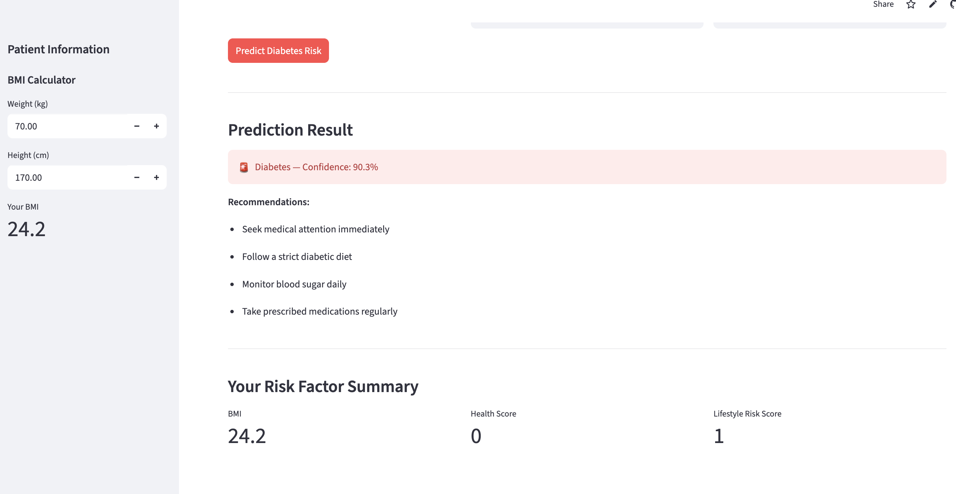

Slide 20
Conclusion
↳ Built end-to-end ML pipeline on 253,680 CDC survey records
↳ XGBoost is the best model with 74.8% accuracy and
most balanced performance across all classes
↳ SHAP analysis confirms GenHlth, HighBP, Age and BMI
are the strongest diabetes risk factors
↳ Feature engineering added value — BMI_Category and
Health_Score both appear in top 10 SHAP features
↳ Prediabetes remains the hardest class to predict due
to severe underrepresentation (1.83%) in the dataset
— a known real world healthcare challenge
↳ Streamlit app successfully deployed for real-time
diabetes risk prediction

Slide 21
Thank You
Questions?
Ritik Sunil Toksiya
ritiktoksiya99.github.io
linkedin.com/in/ritik-toksiya
https://5nrf2swp2buptpmwwiklxg.streamlit.app

